Slide 1
Introduction to Data Science Data Mining for Business Analytics
Brian d’Alessandro
Adjunct Professor, NYU
Fall 2015
Fine Print: these slides are, and always will be a work in progress. The material presented herein is original, inspired, or borrowed from others’ work. Where possible, attribution and acknowledgement will be made to content’s original source. Do not distribute, except for as needed as a pedagogical tool in the subject of Data Science.
Notes:
https://www.youtube.com/watch?v=aMDe5pODkB0 (harlan harris)

Slide 2
Linear Modeling: Statistical learning theory Logistic Regression Support vector Machines
Notes:
The goal of finding structure is to information from one source to reduce uncertainty about another source.
What does this mean? Conditional distribution example. I.e., carnival guy who guesses your weight. If I can see your height I can reduce uncertainty about weight.
Find some height/weight data.
Under supervised exploration:
How can we (automatically) obtain a selection of the more informative variables with respect to predicting the value of the target variable?
Even better, can we obtain the ranking of the variables?
Can think of importance as one that makes the target variable more pure. This leads to the notion of entropy.

Slide 3
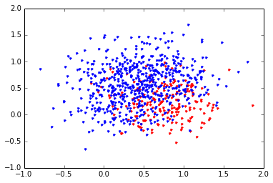
Review – how to classify
Decision Trees use a greedy algorithm to minimize the entropy. It does this by using Boolean operators to partition the feature space.

Slide 4
Linear models
Linear models also partition the feature space, but do so by finding an optimal linear separating hyper-plane, which is found by using principles of statistical learning theory.

Slide 5
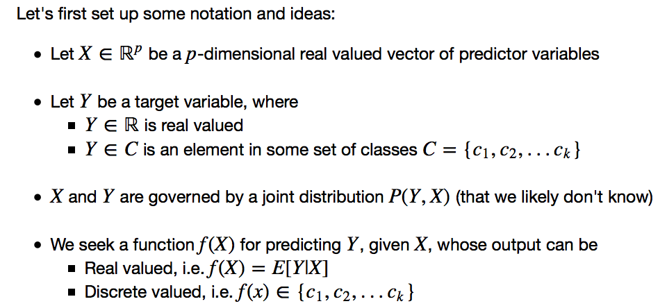
Statistical learning theory

Slide 6
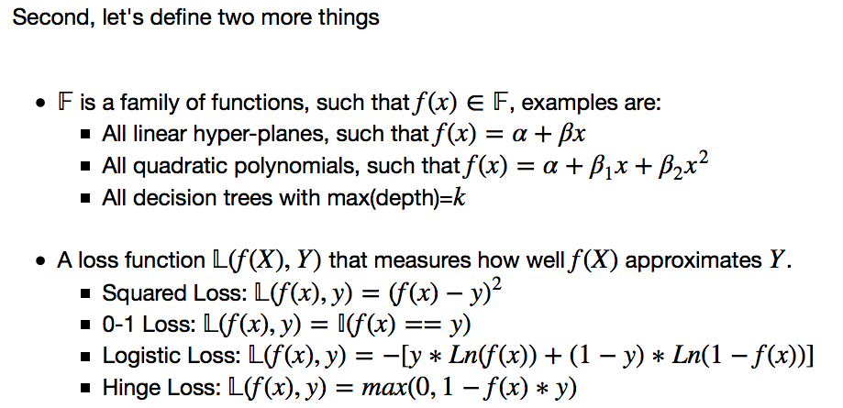
Statistical learning theory
In this lecture we’ll focus on linear models with either Logistic Loss (i.e., logistic regression) or Hinge Loss (Support Vector Machine).

Slide 7
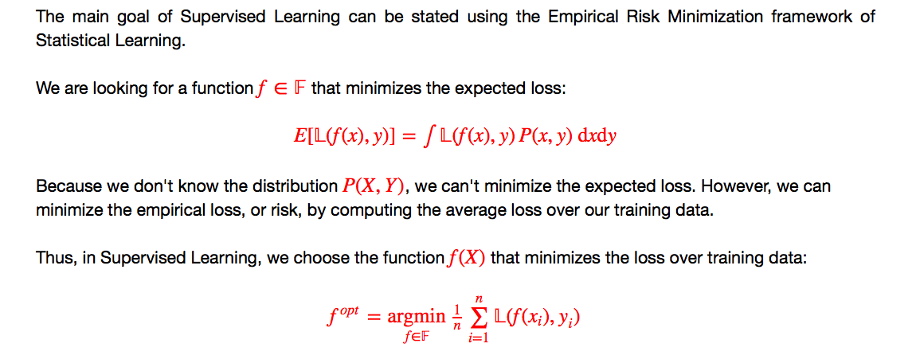
Statistical learning theory
This concept of Empirical Risk Minimization will the basis for understanding the linear models presented later, as well as for understanding the very important principle of bias-variance tradeoffs.
Notes:
Fix the integral here (from ipython)

Slide 8
Logistic Regression
Notes:
The goal of finding structure is to information from one source to reduce uncertainty about another source.
What does this mean? Conditional distribution example. I.e., carnival guy who guesses your weight. If I can see your height I can reduce uncertainty about weight.
Find some height/weight data.
Under supervised exploration:
How can we (automatically) obtain a selection of the more informative variables with respect to predicting the value of the target variable?
Even better, can we obtain the ranking of the variables?
Can think of importance as one that makes the target variable more pure. This leads to the notion of entropy.

Slide 9
A binary regression?
Logistic Regression was created as a binary extension of Ordinary Least Squares Regression.
What linear function fits this data?

Slide 10
Linear Least squares – not so good
The linear least squares curve gives us a reasonable fit in certain areas, but is not constrained to the interval [0,1]. This is bad when you want to estimate a probability.

Slide 11
Something better?
It would be better if we had some function that was linear in its parameters,
but behaved better as a probability estimator.

Slide 12
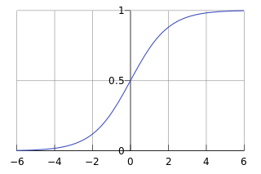
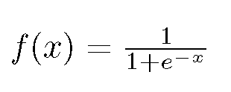
The inverse logit
The inverse logit is just the function we are looking for.

Slide 13
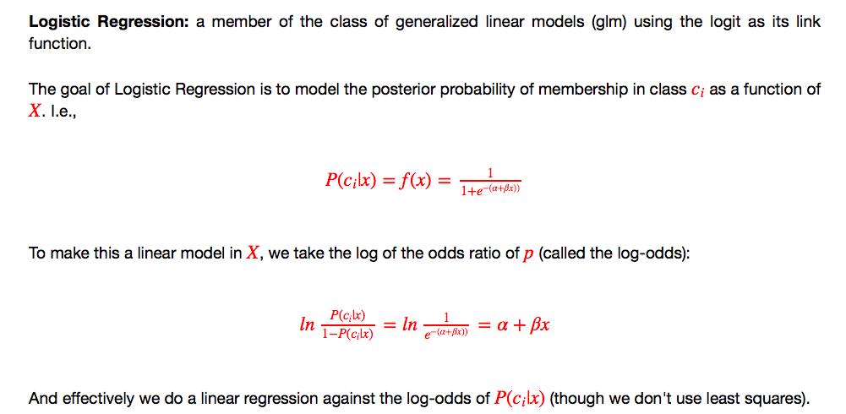
Logistic regression

Slide 14
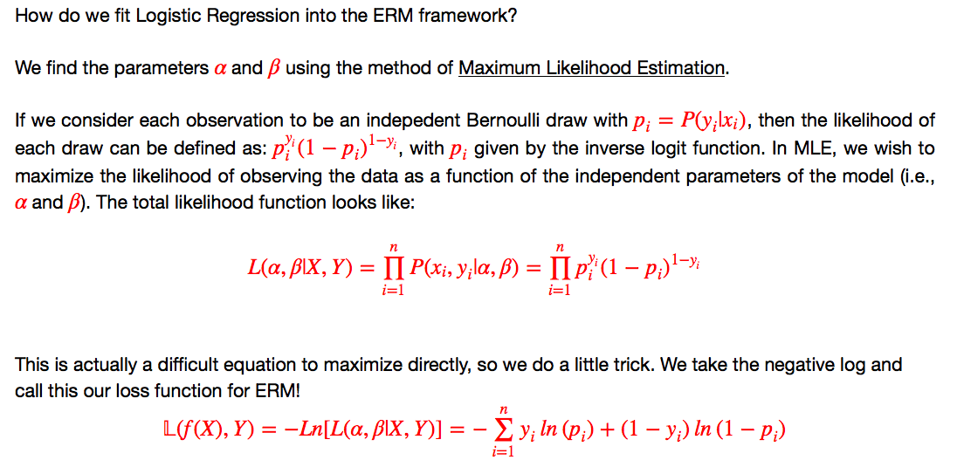
Logistic regression as erm

Slide 15
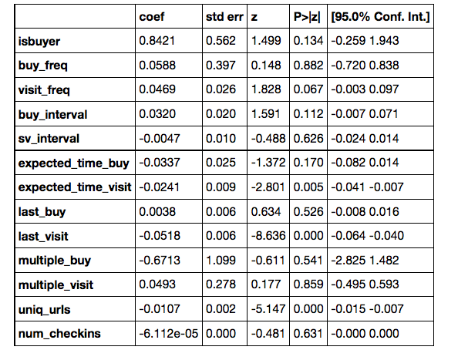
LR: statS vs. Machine Learning?
MLE is a method used traditionally in statistics while ERM is used in machine learning. Logistic Regression works in both disciplines. An advantage of “statistical” point of view is that we can do hypothesis testing on the parameter estimates of the model.
Model Statistical Analysis
coef – the estimate for β
std err – the standard error for the estimate of β
z – the z-score for hypothesis testing on the estimate of β
P>|z| – the p-value (prob of type 1 error) for asserting that β!= 0.
[95% Conf Int] – the 95% conf. interval for the estimate of β
Note: I used pythons statsmodel package as opposed to scikit-learn to get this summary. See accompanying ipython notebook for examples.

Slide 16
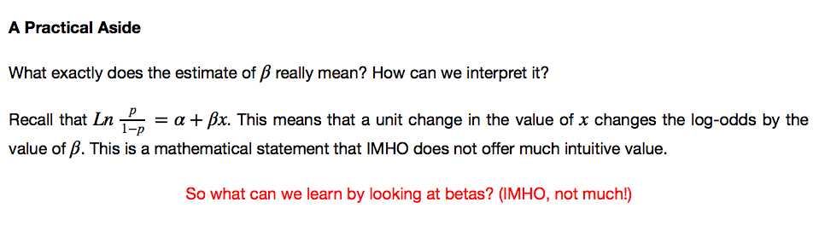
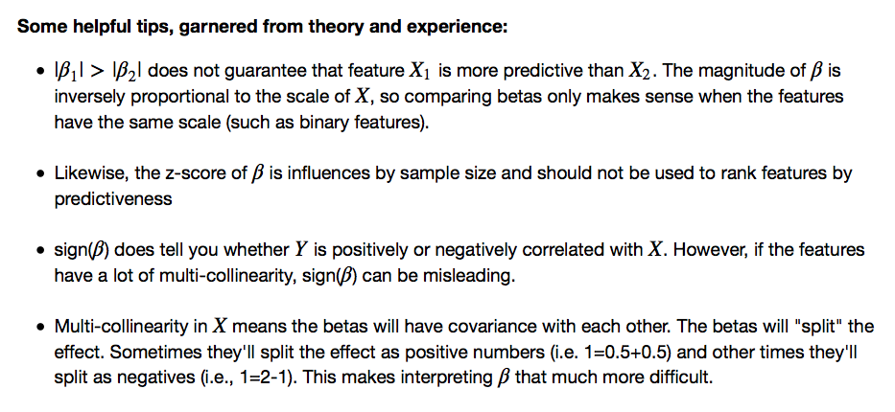
Interpreting betas

Slide 17
Robustness of LR
Not all scenarios involve “Big Data.” Logistic Regression has been proven over and over to be very robust in small data problems.
Learning curve analysis shows that LR performs better than DT in small data scenarios
Source: Tree Induction vs. Logistic Regression, a Learning Curve Analysis. Perlich, Provost and Simonoff

Slide 18
support vector machines
Notes:
The goal of finding structure is to information from one source to reduce uncertainty about another source.
What does this mean? Conditional distribution example. I.e., carnival guy who guesses your weight. If I can see your height I can reduce uncertainty about weight.
Find some height/weight data.
Under supervised exploration:
How can we (automatically) obtain a selection of the more informative variables with respect to predicting the value of the target variable?
Even better, can we obtain the ranking of the variables?
Can think of importance as one that makes the target variable more pure. This leads to the notion of entropy.

Slide 19
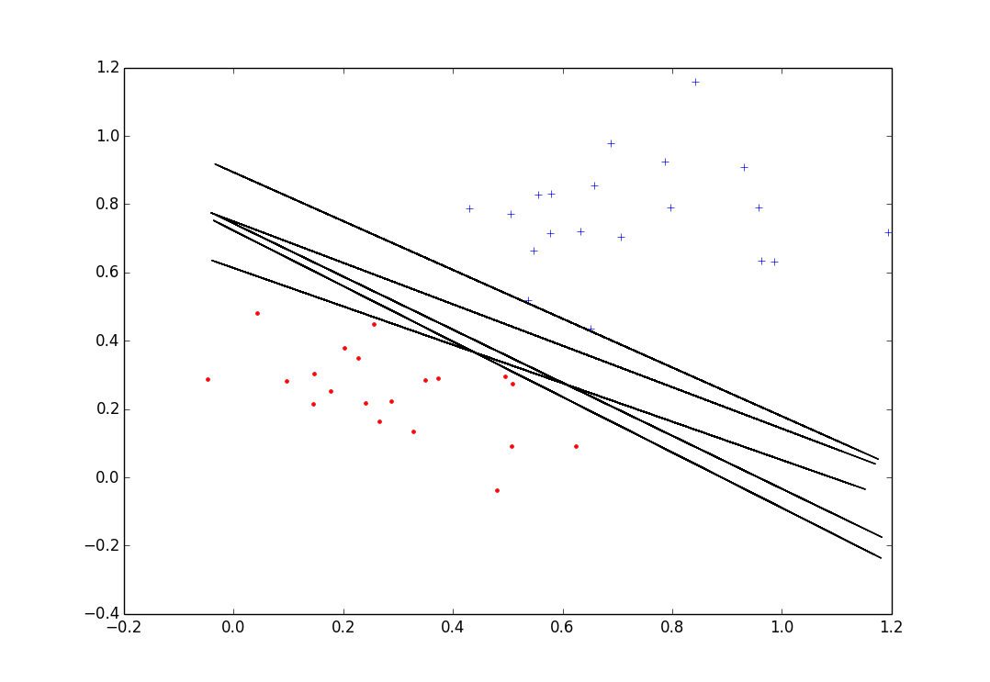
Separating hyperplanes
When data is separable, there is often more than one hyper-plane that can perfectly separate the data.
Given so many choices, it would be nice to have a principled way to choose an optimal one.

Slide 20
Separating hyperplanes
Ideally, we want a line that is as far from all points as possible.
A safe bet would be a line that sits as close to the middle of the empty separating the two classes
Not Ideal!

Slide 21
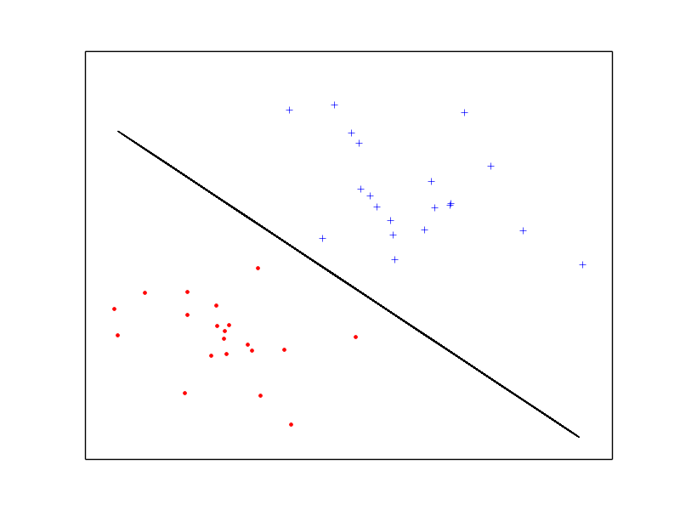
Maximal margin hyperplane
We can formalize our intuition of searching for a plane that is maximally far from as many points as possible.

Slide 22
Some fundamentals
We’ll start with some basic linear algebra
We have a feature space:
A hyper-plane:
W
Q
A normal vector:
X^{i}
Distance(X^{i}, plane)
The distance of X^{i} to the line is given by the projection of the segment QX^{i} onto W and is given by:

Slide 23
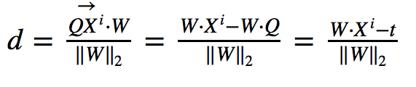
Distance to the plane
How did we get that distance?
If we define a point Q on the line, then the distance from X^{i} to the line is equal to the orthogonal projection of the vector QX^{i} to the normal vector W.
W
Q
X^{i}
d

Slide 24

Adding constraints
If we add some constraints, the problem becomes easier to solve.
M⁺ = distance of closest positive point to W
M⁻ = distance of closest negative point to W
With the constraint:
M⁺ = M⁻ = m = 1
The margin then becomes:
and this is what we seek to maximize.
W
W*X = -t + m
W*X = -t - m
W*X = -t

Slide 25

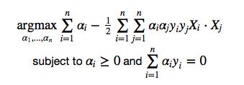
The optimization problem
Maximizing: is equivalent to the following optimization problem:
The constraints ensure that all points are on the correct side of the line.
This can be solved with Convex Optimization and the method of Langrange Multipliers (beyond the scope of this class)
There is a “dual-form” that is equivalent to searching for the support vectors – i.e., the points on the lines WX=-t+/-m

Slide 26
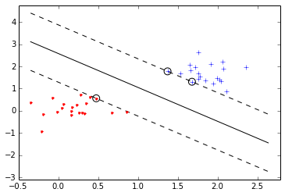
Et voila!
An optimal separating hyper-plane along with margin planes and support vectors identified.
Classification of a new point X then becomes: f(X) = sign(W*X + t).
Effectively, we are finding which side of the line a new point is on.

Slide 27
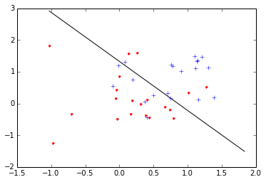
reality
This is somewhat of an unrealistic scenario. Data is seldom this cleanly separated.
Real data looks more like this.

Slide 28
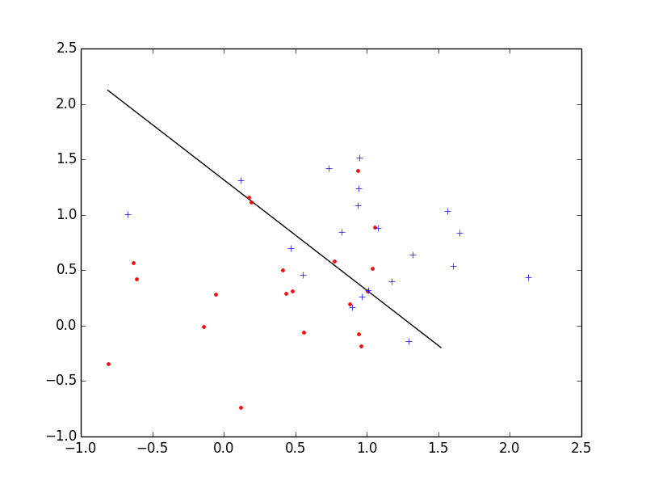
Introducing slack variables
We can account or errors in our problem by introducing slack variables, which measure distance of a misclassified points to the margin.
(Hinge Loss)

Slide 29
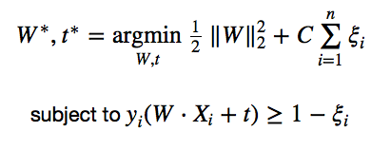

Soft margin SVM
Our optimization problem now can be written:
Which can also be expressed as:
Where λ = 1/2C

Slide 30
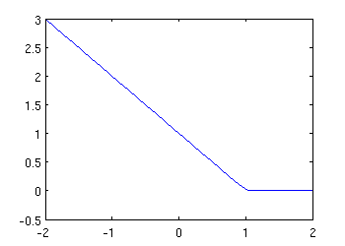
Soft margin SVM as ERM
With this formulation we are trying to do two things:
Maximize the margin
Minimize the training error (hinge loss)
Example Hinge Loss

Slide 31
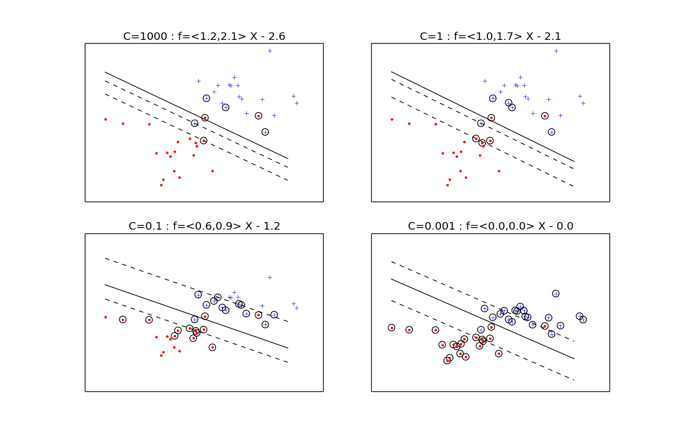
Controlling error tolerance
We control our error tolerance with the parameter C. As we decrease C, we shrink W (increase the margin) and also allow for more support vectors.

Slide 32
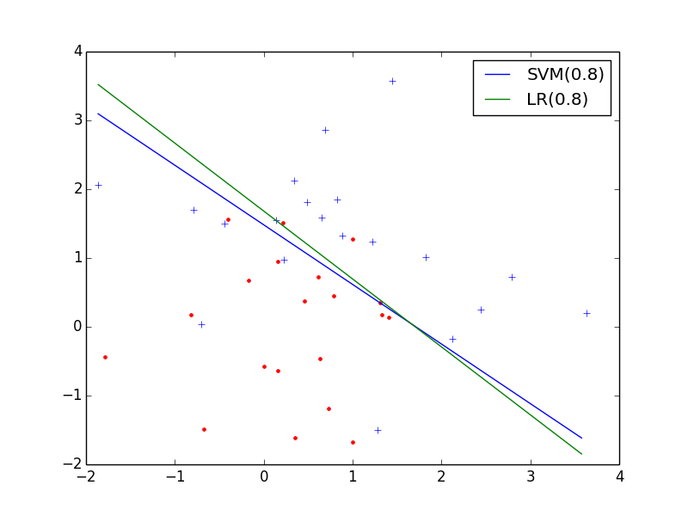
Svm vs. logreg
When dealing with linear models for classification, SVMs and Logistic Regression have very similar solutions. When to use which is a matter of needing to exploit properties beyond the decision boundary.
SVM vs. LR on Simulated Data
SVM
Strong geometric interpretation
Easily extendable to non-linear decision surfaces
Strong learning guarantees
LR
Designed for P(Y|X)
Strong statistical properties
Suited for ranking

